Slide 1
User Interface Design
Instructor: Mehroze Khan

Slide 2
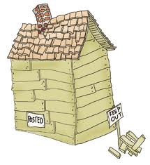
A House
Without doors, windows!!!
Utility connections!!
Similarly, a software without any interfaces is
of no use!!

Slide 3
Interfaces
Between Components
E.g. A gas pipe from kitchen to living room
E.g. A class calling method of another class
Between Self and External Entities
E.g. Gas connection from SNGPL/SSGPL, water connection from WASA
E.g. Our software interacting with bank, NADRA
Between Self and Human
E.g. Door bell, button to switch on a tube light/fan
E.g. A User clicking on print button, login button, post button on screen

Slide 4
Interfaces
A User Interface can be:
Command Line
Graphical

Slide 5
GUIs
Reduced many interfacing problems
Found to be difficult to learn, hard to use, confusing in some cases?
Any experiences?
UIs should be easy to:
Learn
Use
Understand

Slide 6
Designing User Interface
An effective communication medium between a human and a computer
Identification of interface objects and actions
Creation of a screen layout
Study of people and how they relate to technology by answering questions like:
Who is the user?
How does the user learn to interact with the system?
How does the user interpret info produced by the system?
What will the user expect of the system?

Slide 7
User Interface
As technologists studied human interaction, two dominant issues arose.
First, a set of golden rules were identified. These applied to all human interaction with technology products.
Second, a set of interaction mechanisms were defined to enable software designers to build systems that properly implemented the golden rules.
These interaction mechanisms, collectively called the user interface, have eliminated many problems associated with human interfaces.

Slide 8
Golden Rules
Place the User in Control
Reduce User’s Memory Load
Make the Interface Consistent

Slide 9
Place the user in control
System should react to user needs
System should help the user complete tasks
User should not feel that the system is controlling the user

Slide 10
Place the user in control
Design Principles:
Define interactions such that a user is not forced into unnecessary/undesired actions/modes
Provide flexible interaction
User should not feel that the system is controlling the user
Allow interruptible and undoable user interactions
Streamline interactions based on skill level, allow interactions to be customized
Hide technical internals from casual user
Provide mechanism for direct interaction with objects on screen
Notes:
For example, if autocorrect is selected in a text messaging app menu, the software performs autocorrect continually. There is no reason to force the user to remain in autocorrect mode
For example, software might allow a user to interact via keyboard commands, mouse movement, a digitizer pen, a multitouch screen, or voice recognition commands
The advanced user can then create a custom macro—a predefined sequence of actions—based on their frequently repeated tasks. They can record their actions within the software, effectively creating a macro that encapsulates the entire sequence of interactions.
The user should not be aware of the operating system, file management functions, or other arcane computing technology.
For example, an application interface that allows a user to drag a document into the “trash” is an implementation of direct manipulation.

Slide 11
Reduce the user’s memory load
The more a user has to remember, the more error-prone the interaction
Design principles:
Reduce demand on short term memory
Establish meaningful defaults
Define shortcuts that are intuitive
Visual layout must be based on real world metaphor
Disclose information in a progressive manner
Notes:
Remote Control with Labeled Buttons, Traffic Signs and Signals
Web Browser Settings, Smartphone Display Settings. However, a “reset” option should be available, enabling the redefinition of original default values
Ctrl-C to invoke the copy function, the mnemonic should be tied to the action in a way that is easy to remember (e.g., first letter of the task to be invoked)
For example, a bill payment system should use a checkbook and check register metaphor to guide the user through the bill paying process. A room layout application should allow users to drag furniture from a visual catalog and arrange it on the screen using a touch interface.
Information about a task, an object, or some behavior should be presented first at a high level of abstraction. More detail should be presented after the user indicates interest.

Slide 12
Make the interface consistent
Maintain design rules for all screens
Design principles:
Allow user to put current task into a meaningful context
Maintain consistency across a complete product line
Avoid violating de facto standards
Notes:
Many interfaces implement complex layers of interactions with dozens of screen images. It is important to provide indicators (e.g., window titles, graphical icons, consistent color coding) that enable the user to know the context of the work at hand. In addition, the user should be able to determine where he has come from and what alternatives exist for a transition to a new task.
A family of applications (i.e., a product line) should implement the same design rules so that consistency is maintained for all interaction. Microsoft Office includes several software applications such as Word, Excel, PowerPoint, Outlook, and others
Once a particular interactive sequence has become a de facto standard (e.g., the use of alt-S to save a file), the user expects this in every application encountered. A change (e.g., using alt-S to invoke scaling) will cause confusion.

Slide 13
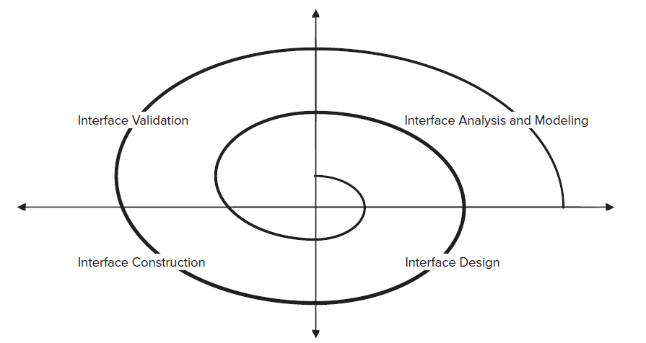
User Interface Design (UID) Process

Slide 14
User Interface Design (UID) Process
Interface Analysis
User Model
Profile of end user
Age, gender, education, physical abilities, cultural/ethnic background etc.
Novice, Knowledgeable, Knowledgeable frequent users
Design Model
Mental Model
User’s perception of the system
Implementation Model
Combines outward manifestation of the computer-based system (the look and feel of the interface), coupled with all supporting information (books, manuals, videotapes, help files) that describes interface syntax

Slide 15
User Interface Design (UID) Process
Interface Design
Define interface objects and actions (and their screen representations)
Interface Construction
Creation of prototypes to evaluate usage scenarios
Interface Validation
Ability to implement every user task correctly
Degree to which interface is easy to use
User’s acceptance to user interface as useful

Slide 16
Interface Analysis
User Analysis
Trained professionals? Technicians? Clerks? Etc.
Average level of formal education?
User capability to learn from written material/training?
Expert typists? Do no like keyboard?
Age range?
Users represented predominantly by one gender?
Routine of work? Regular? Overtime?
Frequency of usage?
Primary spoken language of users?
Subject matter experts?
Desire to know underlying technology

Slide 17
Interface Analysis
Task Analysis
Work performed by user in particular circumstances
Tasks/subtasks performed by the user during the work being performed
Problem domain objects manipulated by users
Sequence of work tasks? Flow of actions? The workflow?
Hierarchy of tasks
Techniques used to support task analysis
Use cases
Task Elaboration (functional decomposition or stepwise refinement)
Object Elaboration
Workflow Analysis (Swimlane Diagram)

Slide 18
Interface Analysis
Analysis and display content
Different types of data assigned to consistent locations on screen?
Customizable location of content on screen
Partitioning of large objects (e.g., reports) for better understanding
Use of colors to improve understanding
Content of error messages?

Slide 19
Interface Design
Define interface objects and operations
Model system behavior on events that change state of the interface
Indicate user interpretation of the state of the system
Notes:
A use case is written. Nouns (objects) and verbs (actions) are isolated to create a list of screen objects and systems actions.

Slide 20
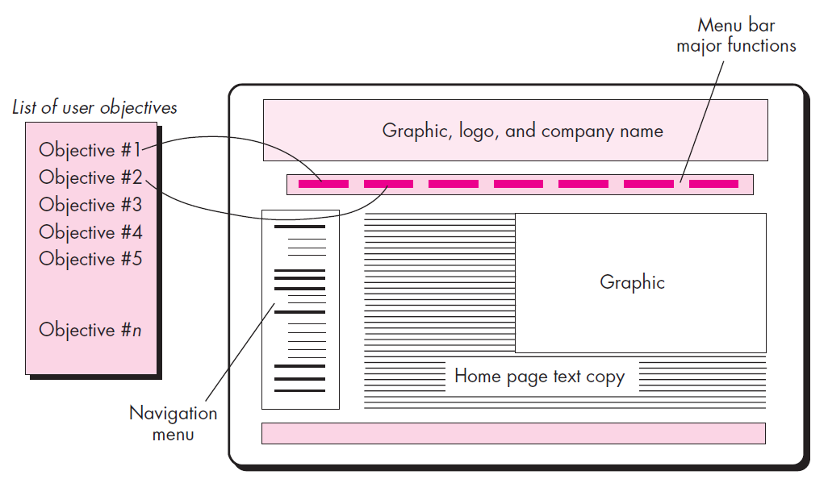
Mapping User Objectives into Interface Actions

Slide 21
Design Issues
Response time
Important characteristics: length and variability
Variability: refers to the deviation from average response time
Low variability enables the user to establish an interaction rhythm
Help facilities
Help for all system functions?
How will user request help?
Help representation?
Notes:
For example, a 1-second response to a command will often be preferable to a response that varies from 0.1 to 2.5 seconds

Slide 22
Design Issues
Error information handling
message should describe the problem
message should provide constructive advice for recovery
message should indicate any negative consequences of the error
message should be accompanied by an audible or visual cue
The message should be “non-judgmental”
Menu and Command labeling
Power users?
Will every menu option have a corresponding command?
How difficult will it be to learn and remember the commands? What can be done if a command is forgotten?
Can commands be customized or abbreviated by the user?

Slide 23
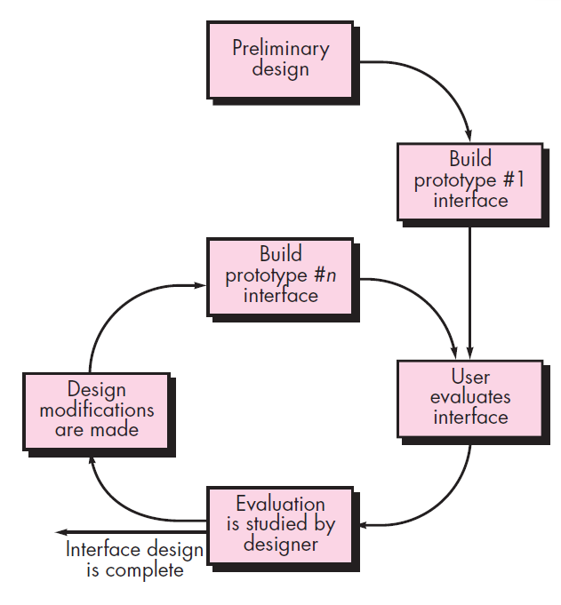
Interface Design Evaluation Cycle

Slide 24
References
Roger S. Pressman, Software Engineering A Practitioner’s Approach, 9th Edition. McGrawHill

